Slide 1
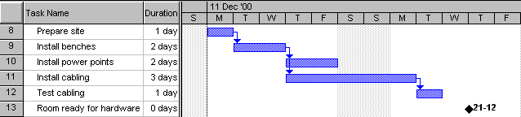
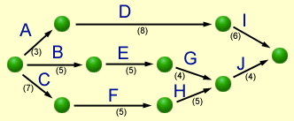

Having Fun with
Gantt
PERT
&
Abhijit Sen
Douglas College

Slide 2
Having Fun with
Gantt
PERT
&
Abhijit Sen
Kwantlen University College

Slide 3
What are they?
Gantt and PERT charts are both “CPM” (Critical Path Method) tools to:
manage the tasks involved in big and complex projects
let project managers organise time, people, equipment and money
ensure the right people and equipment are in the right place and the right time
allow managers to monitor the progress of a project

Slide 4
Gantt Basics
Basically, a timeline with tasks that can be connected to each other
Note the spelling!
It is not all-capitals!
Can be created with simple tools like Excel, but specialised tools like Microsoft Project make life easier

Slide 5
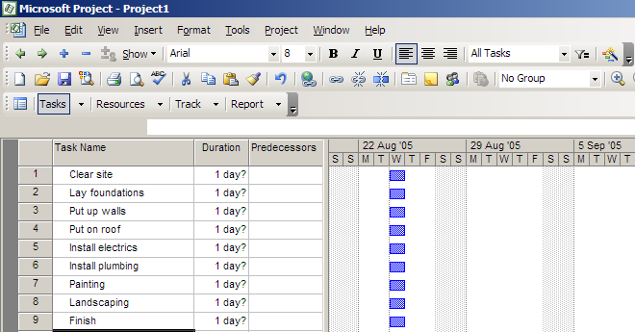
Making a Gantt chart
Step 1 – list the tasks in the project

Slide 6
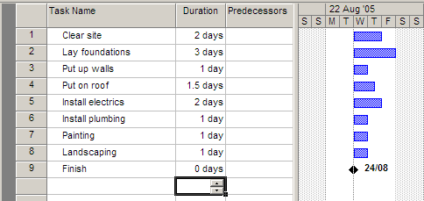
Making a Gantt chart
Step 2 – add task durations

Slide 7
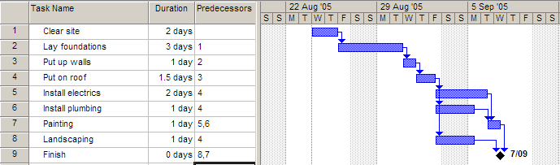
Making a Gantt chart
Step 3 – add dependencies (which tasks cannot start before another task finishes)

Slide 8
Notes
The arrows indicate dependencies.
Task 1 is a predecessor of task 2 – i.e. task 2 cannot start before task 1 ends.
Task 3 is dependent on task 2. Task 7 is dependent on two other tasks
Electrics, plumbing and landscaping are concurrent tasks and can happen at the same time, so they overlap on the chart. All 3 can start after task 4 ends.
Painting must wait for both electrics and plumbing to be finished.
Task 9 has zero duration, and is a milestone

Slide 9
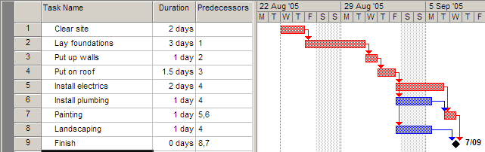
Making a Gantt chart
Step 4 – find the critical path
The critical path is the sequence of tasks from beginning to end that takes the longest time to complete.
It is also the shortest possible time that the project can be finished in.
Any task on the critical path is called a critical task.
No critical task can have its duration changed without affecting the end date of the project.

Slide 10
MS Project can work out the critical path for you!
The length of the critical path is the sum of the lengths of all critical tasks (the red tasks 1,2,3,4,5,7) which is 2+3+1+1.5+2+1 = 10.5 days.
In other words, the minimum amount of time required to get all tasks completed is 10.5 days
The other tasks (6,8) can each run over-time before affecting the end date of the project

Slide 11
The amount of time a task can be extended before it affects other tasks is called slack (or float).
Task 6 can take an extra day and a half before it affects the project’s end date, so each has 1.5 day’s slack.

Slide 12
Critical tasks, by definition, can have NO slack.
Tip:
If ever asked Can task X’s duration be changed without affecting the end date of the project?, if it is a critical task the answer is always NO!

Slide 13
PERT
Charts
PERT
Charts
Stands for Program Evaluation and Review Technique

Slide 14
PERT basics
PERT is an acronym so it’s in capital letters
Gantt is a name, so only has an initial capital
In Gantt chart, the length of a task’s bar is proportional to the length of the task. This rarely applies to PERT charts.
There are a few different “flavours” of PERT and Gantt charts…

Slide 15
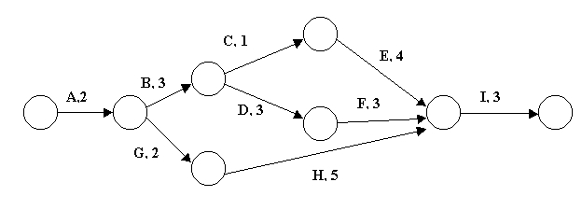
PERT charts
This PERT chart follows the “Activity on Arrow” style.
The tasks are shown by arrows. Task name are shown by letters, in this case.
The circles are called nodes. The nodes indicate the start or end of tasks.
Task durations are the shown by the numbers.

Slide 16
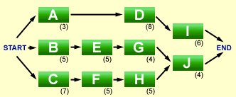
‘Activity on Node’ style PERT
Activity on Node is a different flavour of PERT: this time the nodes are tasks, and the arrows are merely connectors.
The examiners prefer very simple PERT charts – sometimes hybrid beasts that defy categorisation.

Slide 17
A PERT PROBLEM
A PERT PROBLEM

Slide 18
1: Which tasks are on the critical path?
2: What is the slack time for tasks C, D and G?
3: Task C is delayed by one day. What impact would this have on the completion date of the project? Why?
4: Task A will be delayed by 2 days because some equipment has arrived late. If the project manager wants to finish the project on time he will need to shorten the duration of one or more of the tasks. How can he achieve this?
5: The project manager reduces the durations of tasks D and F by one day each. How will this affect the finishing date of the project?
Three minutes of thinking music by Q. Lazzarus

Slide 19
1: Which tasks are on the critical path?
Possible paths:
A,B,C,E,I = 2+3+1+4+3 = 13 days
A,B,D,F,I = 2+3+3+3+3 = 14 days
A,G,H,I = 2+2+5+3 = 12 days
ANSWER: A,B,D,F,I

Slide 20
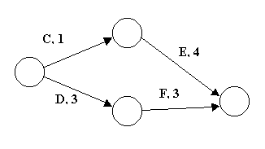
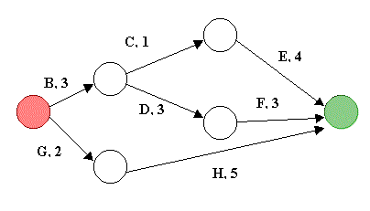
2: What is the slack time for tasks C, D and G?
TASKS C and D…
Path C,E = 5 days, Path D,F = 6 days
Difference (slack) = 1 day for tasks C or E compared to D,F
TASK G…
Path B,C,E = 8 days. Path B, D, F = 9 days
Path G, H = 7 days.
So G & H have 2 days’ slack between them.
B,C or E have 1 day’s slack.
B,D,F have no slack.

Slide 21
3: Task C starts one day late. What impact would this have on the completion date of the project? Why?
No impact, because task C has one day’s slack (as discovered in previous question!)

Slide 22
4: Task A will be delayed by 2 days because some equipment has arrived late. If the project manager still wants to finish the project within the original time frame, he will need to shorten the time for one or more of the tasks. What steps can he take to reduce the number of days allocated to a task?
The answer has NOTHING to do with the chart! Just say how jobs can be finished more quickly, e.g. bringing in extra workers from slack tasks, working longer hours, working weekend, streamlining work practices, automating tasks etc.

Slide 23
5: The project manager decides to reduce the time needed for tasks D and F by one day each. How effective will this reduction be in achieving his aim of maintaining the original finish time for the project?
It is only partially effective. Reducing tasks D and F by one day each means the path A,B,D,F,I is now 12 days long. However, path A,B,C,E,I is still 13 days so it becomes the longest path, and therefore becomes the new critical path.
The project is now 13 days long instead of 14, a saving of only one day.

Slide 24
Some Gantt / PERT Terms
Lead time
Occurs when a task should theoretically wait for its predecessor to finish, but can actually start a little early. The time that the tasks overlap is lead time. E.g. when replacing computers in a computer lab, you could actually start bringing in the new computers while the old ones were being packed up and moved out.

Slide 25
Some Gantt / PERT Terms
Lag time
The minimum amount of time that must pass between the finish of one activity and the start of its successor(s).
For example, if task A is laying a house’s concrete slab, and dependent task B is putting up the house walls, there would need to be some lag time between the end of task A and the start of task B to let the concrete set.
Lag time is shown in a PERT chart as an arrow with a duration but no task assigned to it.

Slide 26
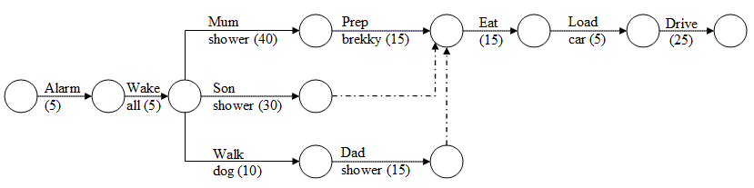
Some Gantt / PERT Terms
Dummy Task
Shown by a dotted arrow on a PERT chart, it shows a dependency but no task. The next example shows this…

Slide 27
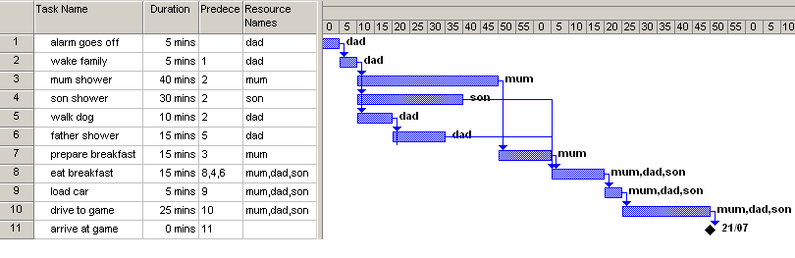
A Family Routine

Slide 28
Questions
Q1. What tasks are on the critical path?
Q2. What is the minimum time it would take for the family to reach the footy game after getting the alarm goes off?
Q3. How much more time could dad walk the dog before eating breakfast got delayed? (Note: Mum insists the entire family eats together)
Q4. What is this amount of time called?
Q5. If mum skipped her 40 minutes shower, how much earlier would they get to the game?

Slide 29
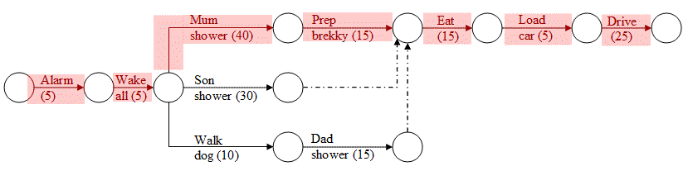
Q1
What is the critical path?
Path 1 = 5+5+40+15+15+5+25 = 110 min
Path 2 = 5+5+30+15+5+25 = 85
Path 3 = 5+5+10+15+15+5+25 = 80
The critical path is the longest path : path 1

Slide 30
Q2
What is the minimum time it would take for the family to reach the footy game after the alarm starts ringing?
The duration of the critical tasks… 110 minutes

Slide 31
Q3 & 4
How much more time could dad walk the dog before eating breakfast got delayed?
What is this amount of time called?
30 minutes…
Shower + Prep Brekky = 55 min vs
  Walk Dog + Dad Shower = 25 min … 30 min diff
Slack time (or float)

Slide 32
Q5
If mum skipped her 40 minute shower, how much earlier would they get to the game?
When the critical path is reduced by 40 minutes, it stops being the critical path.
Path 2, at 85 min, becomes the critical path.
Since it is 25 min shorter than the original 110 minute critical path, there is a 25 minute saving.

